Slide 1
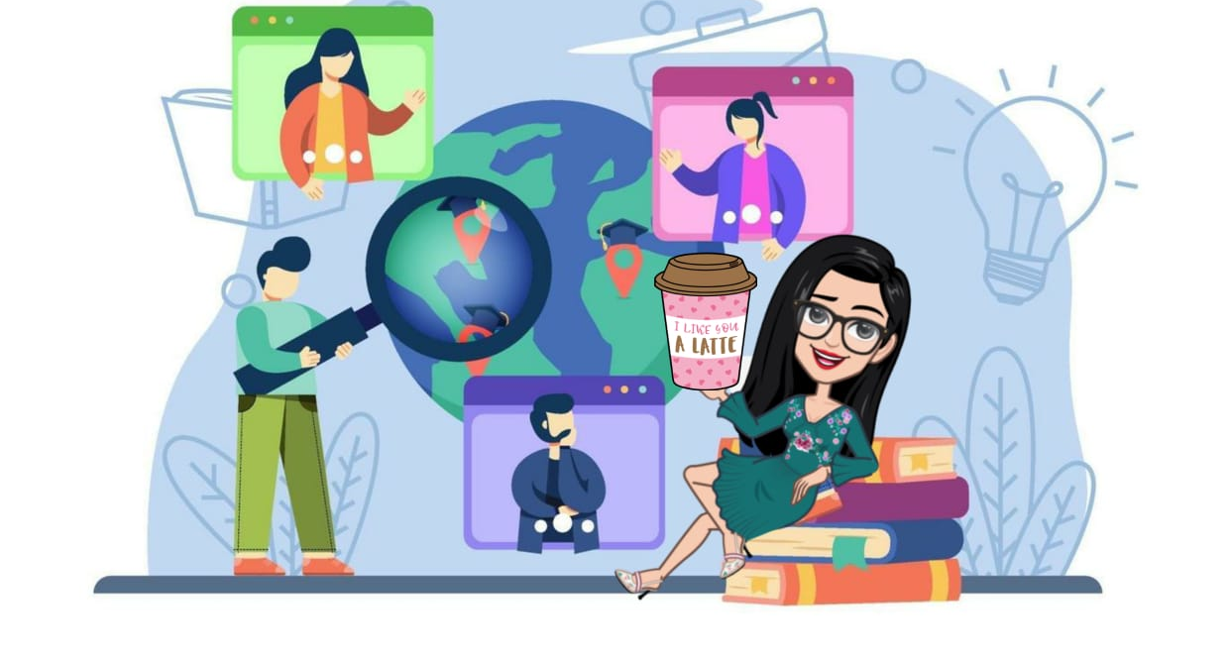

Slide 2
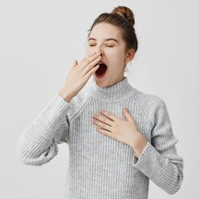
What will be the solutions to this problem?
Problem: I’m sleepy at work.
Solutions: .
The T should add “will” to students’ spontaneous solutions.

Slide 3

Will
Try to match each solution to the corresponding problem:
https://wordwall.net/resource/18258835
1st: ss. On their own
2nd: together in class

Slide 4
What are you going to do…
…tomorrow?
…next week?

Slide 5
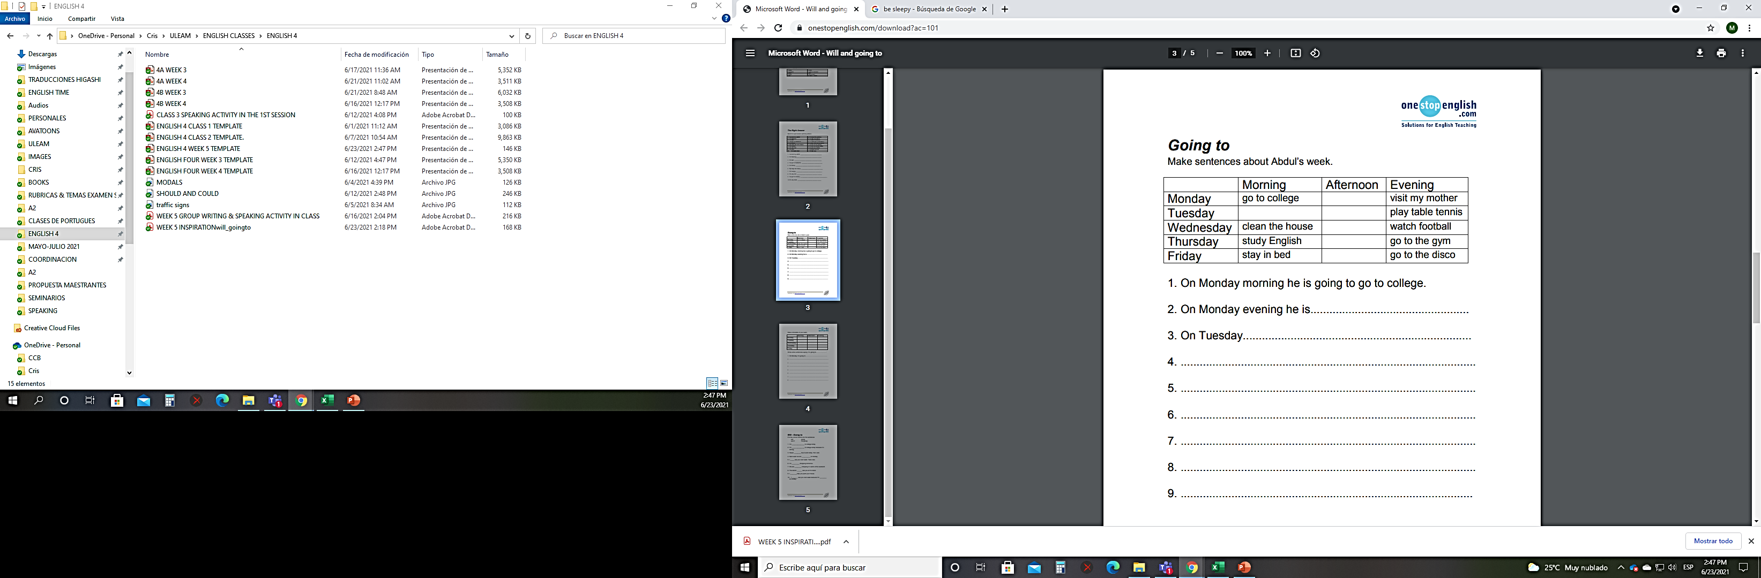
Read through Abdul’s timetable and have students fill in the answers.
n
n
n
n
n
n
n
n

Slide 6
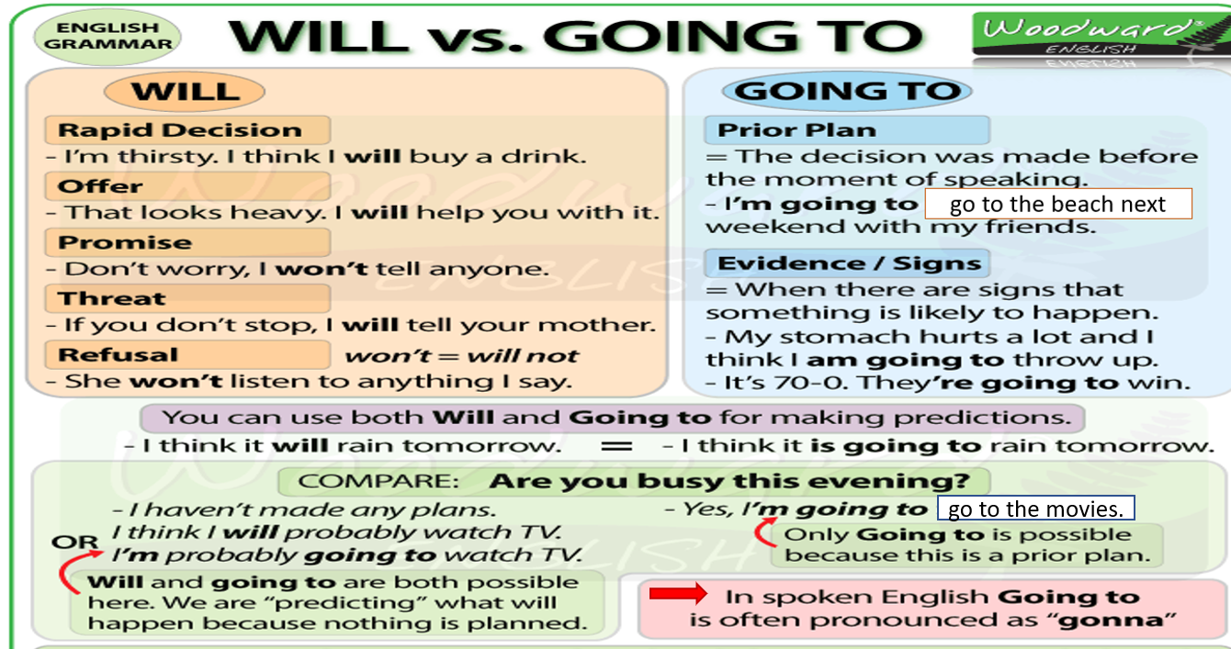

Slide 7
Let’s watch this video!
https://www.youtube.com/watch?v=HTiT63K0KMo

Slide 8
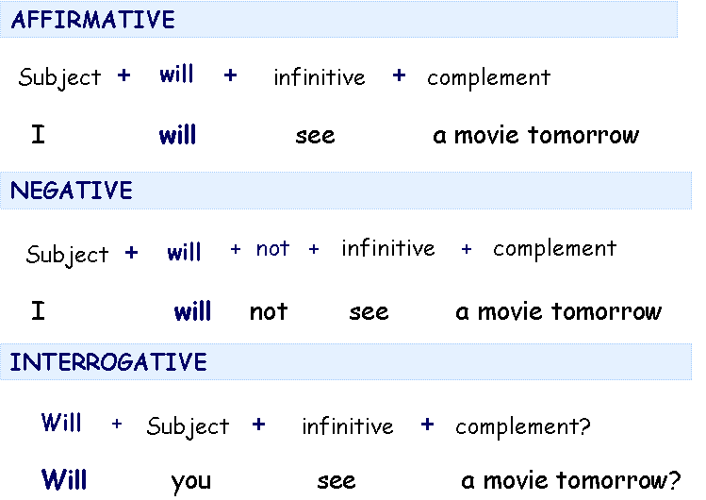

Slide 9
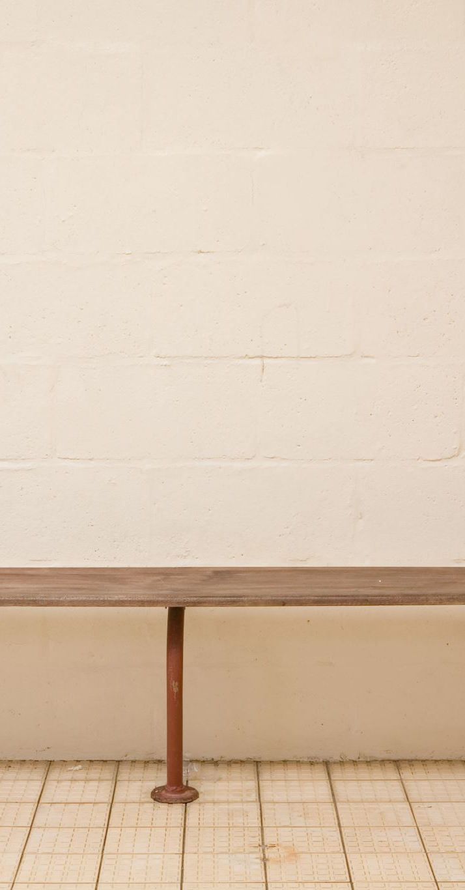
Practice with “will”.
https://agendaweb.org/exercises/verbs/future/will-positive-negative-questions-write

Slide 10
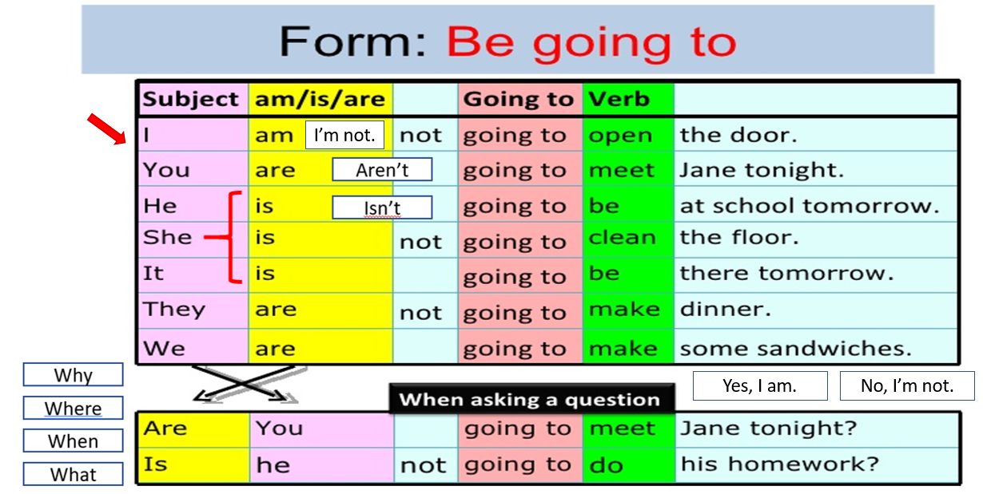

Slide 11
Practice with “going to”.
https://www.superprof.es/apuntes/idiomas/ingles/gramatica-inglesa/verb-tense/exercises-be-going-to-i.html

Slide 12

Reading time
Ss. work on it on their own:
https://es.liveworksheets.com/worksheets/en/English_as_a_Second_Language_(ESL)/Reading_comprehension/Reading_Be_going_to_vs_will_ba1703196lk

Slide 13

Week 5 worksheet
2nd page: ss. work on their own.
T and ss. compare answers in class.

Slide 14

“Will” or “going to”?
https://agendaweb.org/exercises/verbs/future/will-going-to-2

Slide 15

Speaking: “Going to”
https://wordwall.net/resource/18608314

Slide 16
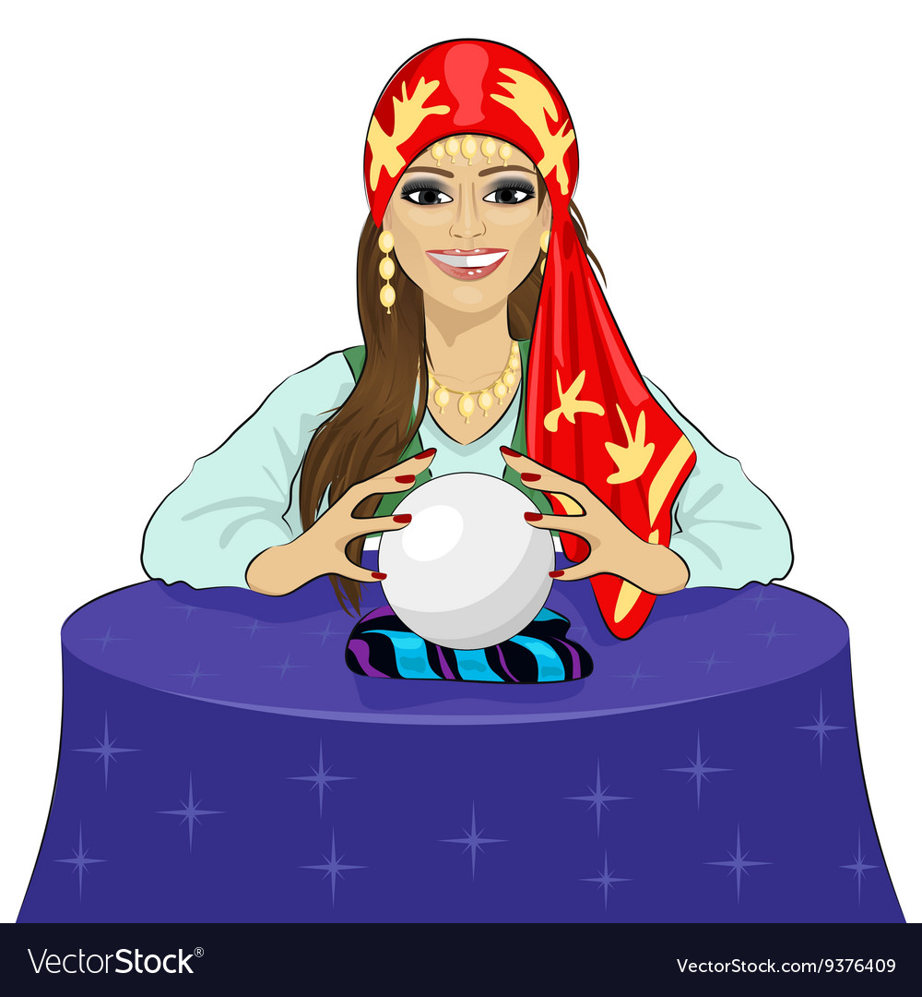
Graded Writing & Speaking activity in groups of three
Create and role play a dialogue between you and a fortune teller using “will”.

Slide 17


